Slide 1
Professional Practice in IT 2019
Muhammed Noumann Zafar
Julie Gardiner

Slide 2
About Our project:
Is a Movie Database where a User can view existing Images and Videos already in the database.
A user can add their own images and videos into the database.

Slide 3
Technologies Used:
MySql Database hosted on Amazon Web Services.
Spring Boot
Speedment
Angular 7

Slide 4
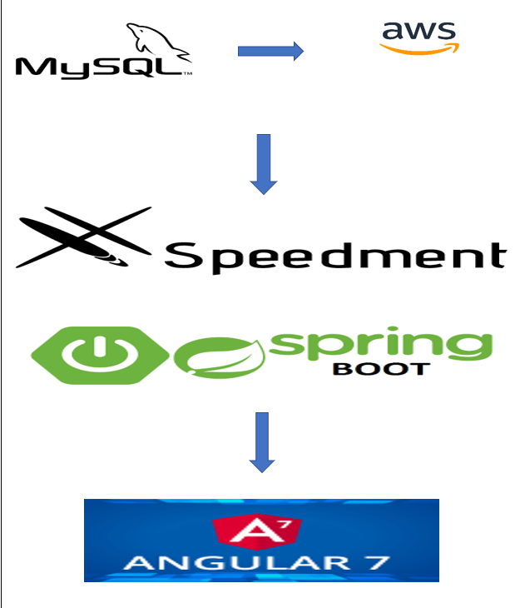
Architecture:

Slide 5
Demonstration

